Slide 1


Green Pace
Security Policy Presentation
Developer: Eric Ginder

Slide 2

OVERVIEW: DEFENSE IN DEPTH
The security policy that I have prepared is needed as it protects Green Pace’s on multiple levels. With correct implementation of the security policies that I have chosen, Green Pace’s security policy will be both effective and maintainable.

Slide 3
THREATS MATRIX
Likely Threats that are very common in the industry and should be checked for. | Priority The highest rank and should be addressed ASAP.
Low priority Uncommon to happen in the workplace, but should be watched for | Unlikely Unlikely to happen unless a serious lax in security standards.
The 10 principles that I have chosen for this security policy cover these threats levels and more displayed on the right.

Slide 4
10 PRINCIPLES
Validate Input Data- Coding Standards 1, 2, 3, 4, 5, 6, 7, 8, 9,
Heed Compiler Warnings- Coding Standards 1, 2, 3, 4, 5, 6, 7, 8, 9,
Architect and Design for Security Policies- Coding Standards 1, 2, 3, 4, 5, 6, 7, 8, 9,
Keep It Simple- Coding Standards 3, 4, 6, 7, 8, 9, 10
Default Deny- Coding Standards 6, 9, 10
Adhere to the Principle of Least Privilege- Coding Standards 9, 10
Sanitize Data Sent to Other Systems- Coding Standards 7, 10
Practice Defense in Depth- Coding Standards 7, 10
Use Effective Quality Assurance Techniques - Coding Standards 7, Coding Standards 9, 10
Adopt a Secure Coding Standard-Coding Standards 9, 10

Slide 5
CODING STANDARDS
STD-010-CPP- High Severity - Properly deallocate dynamically allocated resources – Chosen as the biggest standard to follow, memory problems can really cause a company money if not caught.
STD-003-CPP- High Severity - Do not attempt to create a std:: string from a null pointer. Very important and expensive if a company does not catch, a program can be vulnerable if this Standard I not followed.
STD-004-CPP- High Severity - Do no store an already-owned pointer value in an unrelated smart pointer. This can also lead to a potential vulnerability if not properly handled.
STD-005-CPP- Medium Severity- Detect and handle memory allocation errors. – Very straightforward and common, this security standard should be followed at all times.
STD-008-CPP- Medium Severity- Do not use pointer-to-member operators to access nonexistent members. – Important to remember, this is a fairly common error that might occur, but static checkers are able to search for.
STD-007-CPP- Medium Severity- Handle all exceptions. It goes without saying, but all exceptions that could cause a program to malfunction or crash should be handled.
STD-001-CPP- Low Severity- Do not define a C-style variadic function. This can result in undefined behavior that could be potentially abused if not caught.
STD-002-CPP-Low Severity- Do not cast to an out-of-range enumeration value. A common mistake, and one that is easy using code analyzers to fix.
STD-006-CPP-Low Severity- Use a static assertion to test the value of a constant expression. A mistake that does not happen often, as most assertions are true false.
STD-009-CPP-Low Severity- Close files when they are no longer needed. Straightforward and easy to catch, this coding standard is easy to follow.

Slide 6
ENCRYPTION POLICIES
The policy for Encryption in rest is when data is written into storage on a disk and having the data encrypted. If an attacker manages to get the drive without the keys, they will be unable to read the data. This policy apples to this process because it allows users to safeguard their data when not in use, protecting green pace’s information.
The policy for Encryption in flight is when data is being transmitted from one source to another in some way, often over a network. It is important because encrypting data and ensuring that the users have the proper keys to access the data is important.
The policy for Encryption in use is the method of protecting data so that it is never unsecured, regardless of its lifecycle stage (at rest, in transit), source, or location. This is important to every step of the stage in DevSecOps because it will protect the user at every step of the way if followed correctly.

Slide 7
TRIPLE-A POLICIES
Triple AAA Authentication describes the network or application way of identifying a user and making sure that the user is who they claim to be. This can involve user logins with usernames and passwords. Authentication ensures proper authorization to access a system. Generally, the system compares the users credentials with other credentials stored in the database. From Keep it simple to Validate input data, this security policy’s ten core principles cover every aspect of the AAA.
Triple AAA authorization is the method that is used to enforce policies like determining the activities, services and resources that a user is allowed to use. Users are assigned authorization levels that define their levels of access to a network that dictate what actions a user can do. This can be based on different restrictions, such as geolocation, frequency of logins, etc. This encompasses user levels of access, and addition of new users, as well as changes to the database. Default deny, adhering to principle of least privilege, , this security policy’s ten core principles are well thought out.
Triple AAA Accounting is the measure of resources that a user consumes during access to a network/application. This information is used for authorization control, billing, trend analysis. This ensures that an audit will enable administrators to login and view actions performed by whoever at what time.

Slide 8
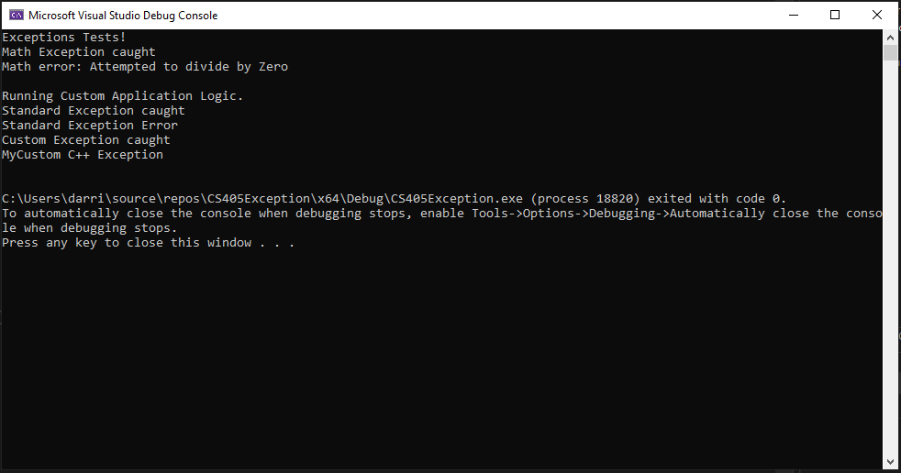
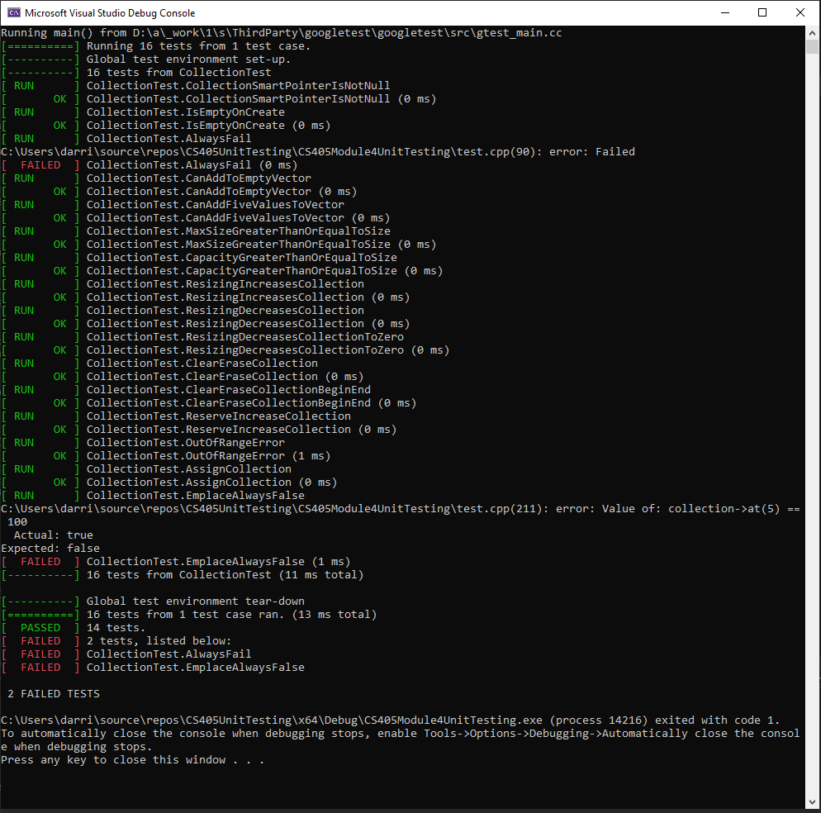
Unit Testing
I ran multiple tests using static checker tools as well as code frameworks that allowed me to test multiple security vulnerabilities. From checking to make sure that smart pointers are not null and all proper memory de-allocations have occurred, Using security frameworks as well as this security policy, Green pace’s information is in good hands.

Slide 9

AUTOMATION SUMMARY

Slide 10
TOOLS
The DevSecOps pipeline is an approach that is continuously improving and re-evaluating security practices to help the software development and deliver processes. By integrating proper security principles, teams and companies can deliver new software at a strong pace without having to sacrifice on security.
External tools such as static code analyzers and unit test frameworks really help a company expedite their testing process and point out minor (or major) security flaws that may have been undiscovered

Slide 11
RISKS AND BENEFITS
Nothing is ever 100 percent secure when it comes to coding, which is why companies practice a multi layered defense that can continuously improve . If a company decides to wait, then those possibly undiscovered vulnerabilities will still exist and possibly be exploited in the future. This security policy should go hand in hand with the overall security policy that a company follows on both the hardware and the software side to ensure proper protection.

Slide 12
RECOMMENDATIONS
For the security policy to constantly be re-visited and re-invented. There are possible vulnerabilities in the code that exist and haven’t been caught yet, and so therefore the company’s security policy should be constantly reviewed and improved upon.

Slide 13
CONCLUSIONS
As technology advances, so to must software and security policies change to meet the new demands that require them. By adopting this security policy and applying them in an efficient manner ( such a zero-trust policy) Green pace will be able to meet any security demand that may happen in the future. This security policy covered critical aspects of security flaws that are prevalent today.

Slide 14
REFERENCES
SEI CERT C++ Coding Standard - SEI CERT C++ Coding Standard - Confluence. (2020, May 29). SEI CERT C++ Coding Standard - SEI CERT C++ Coding Standard - Confluence. Retrieved October 20, 2022, from https://wiki.sei.cmu.edu/confluence/pages/viewpage.action?pageId=88046682

